Slide 1
DevSecOps & Automation- 2023
Naga Harsha Kaggallu
Priyanka Chougule
Last updated date: 21-June-2023

Slide 2
DevSecOps 2023
OKR
Implement Lean practices through DSO maturity coverage for 70% of high ROI products (~120 applications)and achieve overall DSO maturity level of 3+ . Complete assessments & re- assessments for 180+ applications for benchmarking and adding value to applications.

Slide 3
Progress
On Track
Watch Item
Off Track
2023 OKR Targets
Q1
Q2
Target
Completed
Target
Completed
Complete DSO Assessments for new applications 24 Apps
8
6
10
4
Implementation roadmap for Applications that have completed assessments- 10 Apps
5
5
4
4
Roadmap implementation, Re-Assessment & ROI calculation for 15% Apps with roadmap created: - 40 apps
14
6
10
3
*DSO Improvements pending
*DSO Improvements pending
Maturity improvement and maintain Score 3.0+
Maturity Score 3
Maturity Score 3

Slide 4
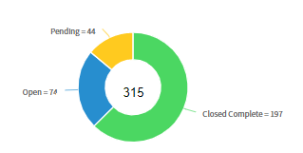
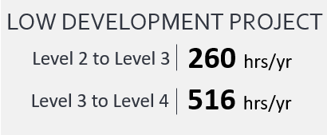
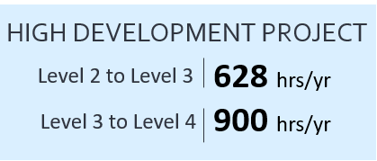
Status
Highlights
Look Ahead
On- track with DSO assessments and overall Maturity
DSO Savings benchmarking in progress to calculate
Monthly News letter for DevSecOps
Bi-Weekly Sessions with Product managers –
Sharing learnings and progress
Release the integrated version of Tableau dashboard.
GSEP Dashboard improvements
DSO Savings benchmarking and calculations for Applications
Risks/Help Required
Application team to prioritize DSO implementation
as per the roadmap . This is important to bring Quality, ROI
Maturity improvement & automation savings

Slide 5
DevSecops Resources
Training:
https://devsecops.web.boeing.com/trainings.html
https://insite.web.boeing.com/culture/viewMedia.do?mediaId=428840
Insite: DevSecOps related video series
Degreed: https://degreed.com/pathway/mpl66o5r9d/pathway
Oreilly: https://learning.oreilly.com/library/view/the-devops-handbook/9781457191381/
Support
In case of any queries interested teams can register themselves through EMC (check for the session with the name “DevSecOps Office Hours (India)”).
For Product Teams in US, Click Here to block your slot
For Product Teams in India, Click Here to block your slot
DSO Support Systems | Description | URL
ATOMS | Platform to onboard to some of the commonly used tools like Coverity, Netsparker, SonarQube | https://atoms.web.boeing.com/home
ATOMS-CI | Saves your team time by generating an automated continuous integration pipeline and integrating different tools | https://atoms-ci.web.boeing.com/ci
DevSecOps | Official DevSecOps website | https://devsecops.web.boeing.com/index.html
Boeing Application Security - Docs | Official Infosec website | https://dev-sec-docs.web.boeing.com
AppDynamics | Monitoring tool documentation | https://itms.pages.boeing.com/wiki/appdynamics/
Enablement kit | Architecture Checklist to improve maturity | https://devsecops.web.boeing.com/assessment/enablementKit.html
DSO Mattermost channel | Join this channel for any questions/updates | https://mattermost.web.boeing.com/dso/channels/town-square
DSO Consultation | Connect with the experts | DL DSO Consulting
DSO COE InSite Group | Join this group for any questions/updates | https://insite.web.boeing.com/culture/viewGroup.do?groupId=168061
DevSecOps Video Library | Videos on different implementation | https://insite.web.boeing.com/culture/displayGroupMedia.do?groupId=168061

Slide 6
Automation Status - 2023
OKR
Implement automation capabilities through out the applications and achieve 80000 automation hours

Slide 7
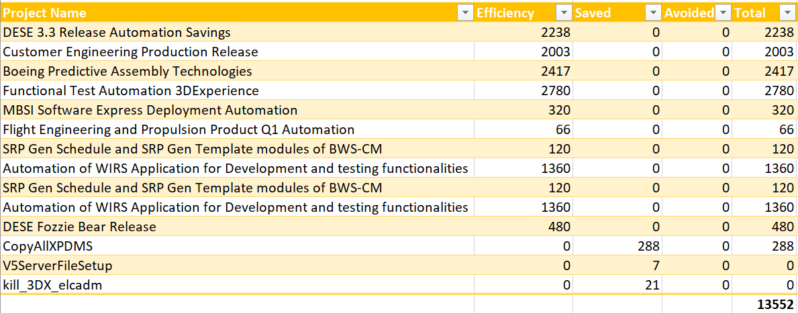
Automation status and progress till date

Slide 8
Next steps
Achieve the targets of 20000 hours for each Director
Continue to assess the Q2 applications and update CoP accordingly
Automation CoP review and update
Help teams to improve in Automation
Create awareness of Automation across all teams

Slide 9
Thank You

